Slide 1
Unusual WWII Photos
Special Thanks to all those who gave their lives and served their country during this insane time in world history.

Slide 2
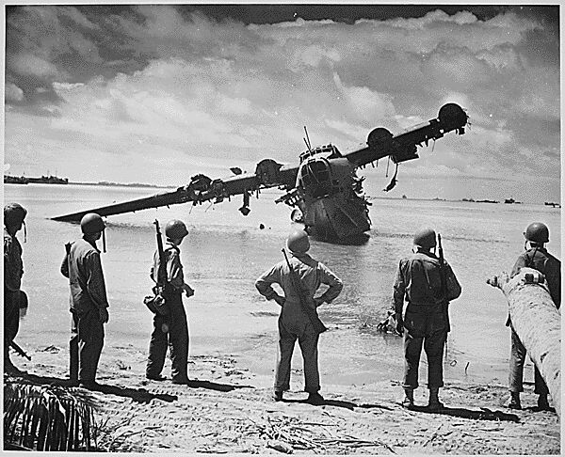
Japanese Kawanishi H8K seaplane after strafing. Kwajalein
Notes:
Japanese Kawanishi H8K seaplane after strafing. Kwajalein

Slide 3
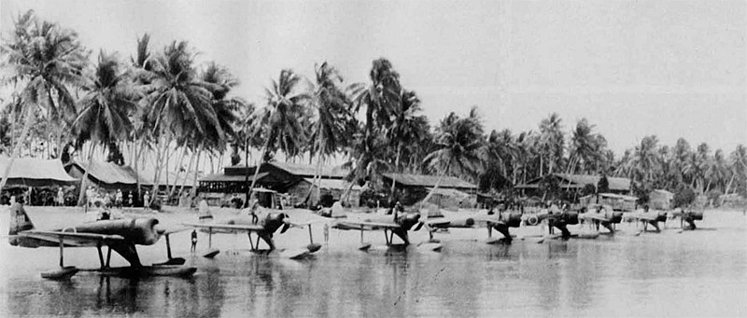
Squad of Rufe's at Bougainville. These things were very nimble even with the damn pontoons.
Notes:
Squad of Rufe's at Bougainville. These things were very nimble even with the damn pontoons.

Slide 4
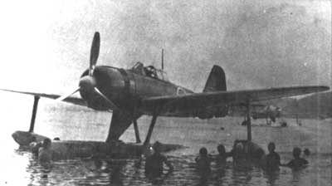
The A6M2-N float plane version of the Zero did extremely well, suffering only a small loss in its legendary maneuverability. Top speed was not affected, however, the aircraft's relatively light armament was a detriment.
Notes:
The A6M2-N float plane version of the Zero did extremely well, suffering only a small loss in its legendary maneuverability. Top speed was not affected, however, the aircraft's relatively light armament was a detriment.

Slide 5
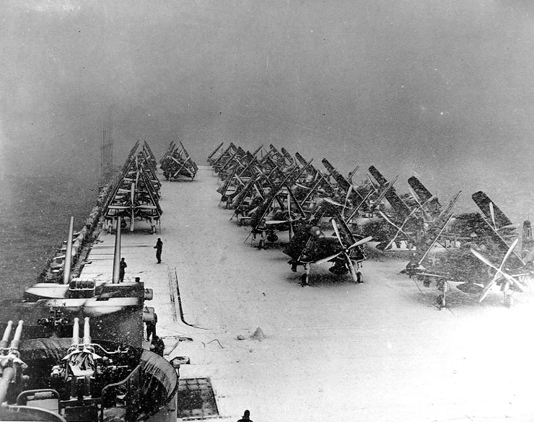
Snow on deck. USS Philippine Sea North Pacific 1945.
Notes:
Snow on deck. USS Philippine Sea North Pacific 1945.

Slide 6
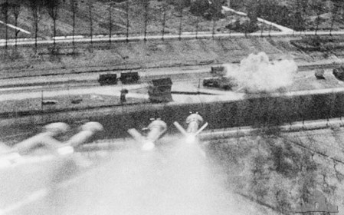
HARVS on the way in shot by a P-47. Rare shot.
Notes:
HARVS on the way in shot by a P-47. Rare shot.

Slide 7
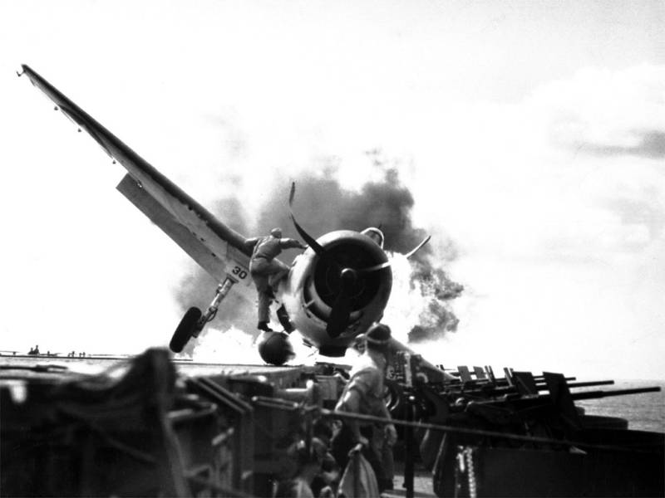
Deck crew climbing up to get the pilot out. He did. That’s a fuel tank his foot is on. Empty?
Notes:
Deck crew climbing up to get the pilot out. He did. That’s a fuel tank his foot is on. Empty?

Slide 8
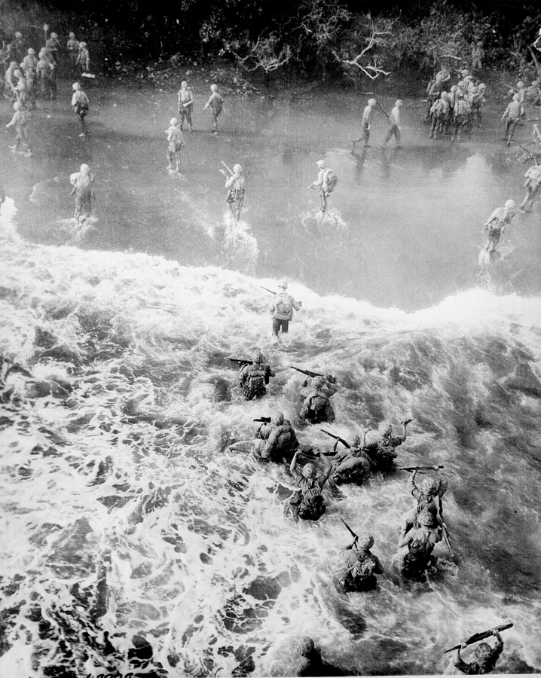
Marines disembark LST at Tinian Island.
Notes:
Marines disembark LST at Tinian Island.

Slide 9
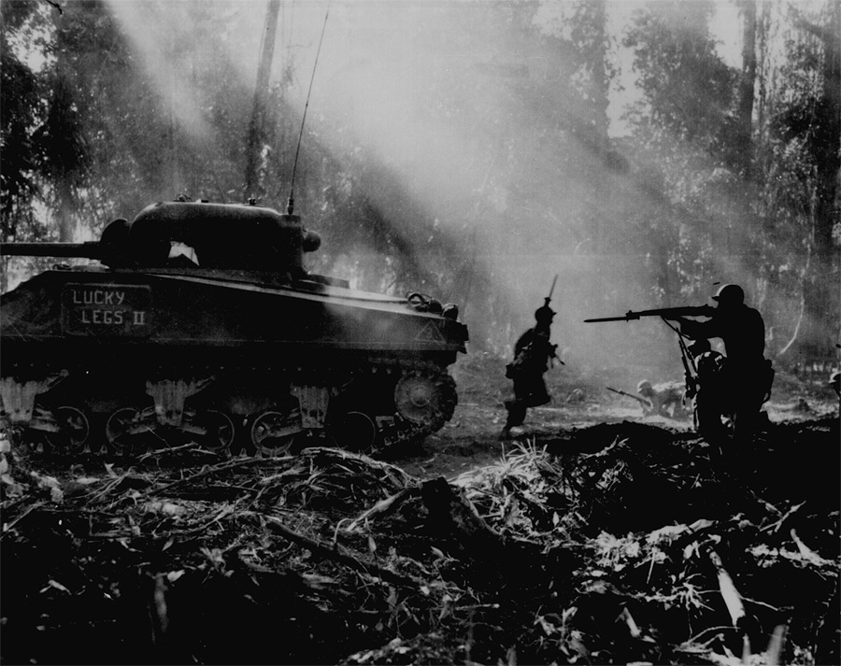
Bougainville.
Notes:
Bougainville.

Slide 10
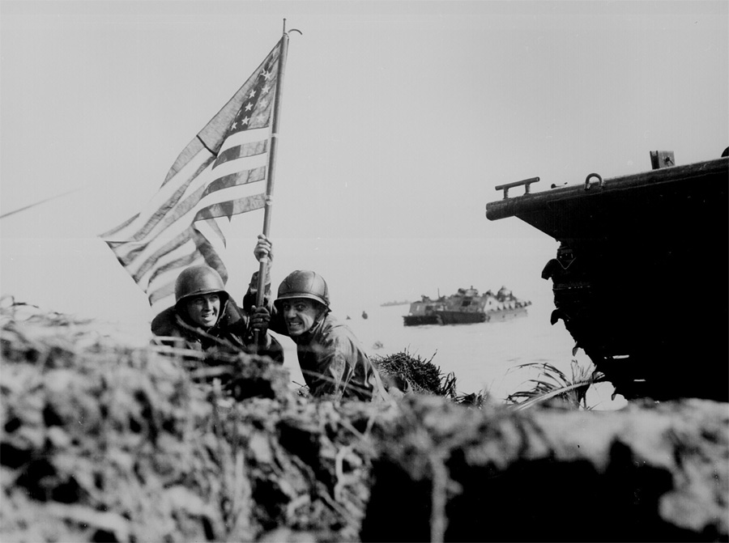
Guam
Notes:
Guam

Slide 11
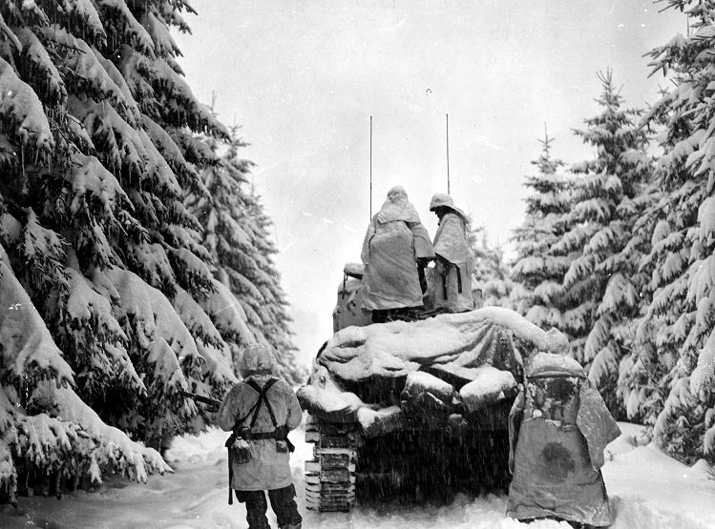
Outside Bastogne
Notes:
Outside Bastogne

Slide 12
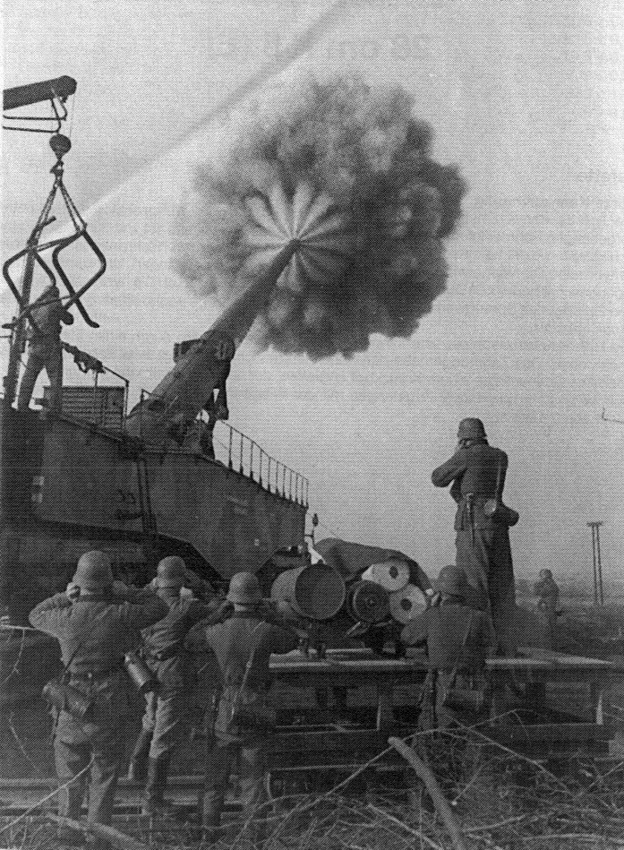
German 280mm K5 firing
Notes:
German 280mm K5 firing

Slide 13
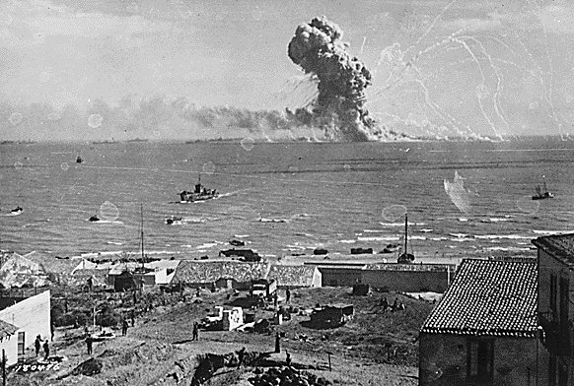
U.S. Munitions Ship goes up during the invasion of Sicily.
Notes:
U.S. Munitions Ship goes up during the invasion of Sicily.

Slide 14
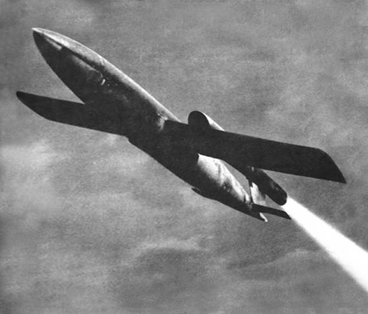
V1 Rocket
Notes:
V1

Slide 15
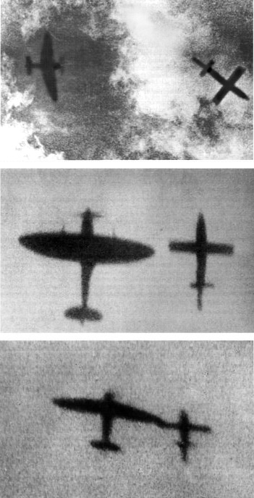
Spitfire "tipping-off" a V1.
If you've never heard of this insane tactic here’s how it’s done.
At first V1's were shot down by gunfire. Optimum range was inside 200yds, which was marginal for survival. Many planes were damaged and quite a few pilots killed. Basically at such high speed and low altitude a plane had to fly though the explosion and hope. With the high risk of being blown up some of the best pilots started tipping the V1's wing, because of damage to wing tips they later developed a tactic of disrupting the air flow by placing their wing very close to the V1's wing, causing it to topple.
Not every pilot did this. At night this was not possible, the flame from the V1 blinded the pilot to everything else, though some Mossie pilots flew past closely in front of the V1, again causing it to topple. The thought of doing this at 450mph, 4,000 feet above the ground, at night and being blinded gives me the willies.
Notes:
Spitfire "tipping-off" a V1. If you've never heard of this insane tactic ....
At first V1's were shot down by gunfire. Optimum range was inside 200yds, which was marginal for survival. Many planes were damaged and quite a few pilots killed. Basically at such high speed and low altitude a plane had to fly though the explosion and hope. With the high risk of being blown up some of the best pilots started tipping the V1's wing, because of damage to wing tips they later developed a tactic of disrupting the air flow by placing their wing very close to the V1's wing, causing it to topple.
Not every pilot did this. At night this was not possible, the flame from the V1 blinded the pilot to everything else, though some Mossie pilots flew past closely in front of the V1, again causing it to topple. The thought of doing this at 450mph, 4,000 feet above the ground, at night and being blinded gives me the willies.

Slide 16
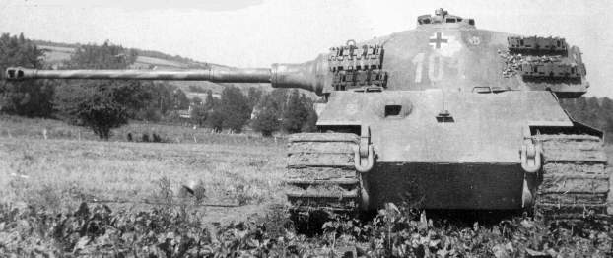
Panzerkampfwagen VI "E Tiger"
Notes:
Panzerkampfwagen VI "E Tiger"

Slide 17
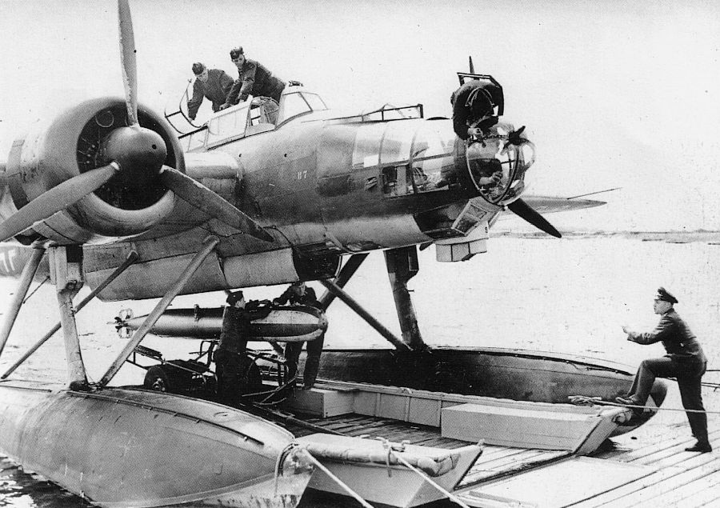
Ju 88 loading a torpedo. This is one HUGE bomber ... and it's on pontoons.
Notes:
Ju 88 loading a torpedo. This is one HUGE bomber ... and it's on pontoons.

Slide 18
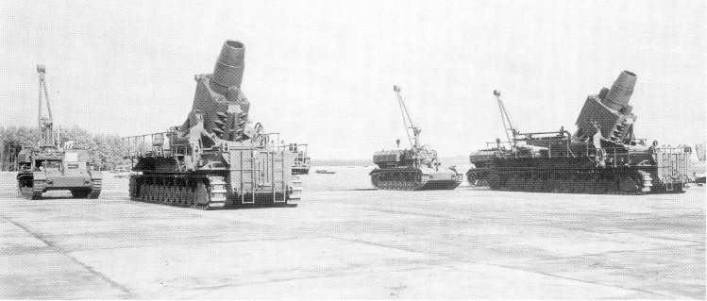
German "KARL" mortars. Sebastopol
Notes:
German "KARL" mortars. Sebastopol

Slide 19
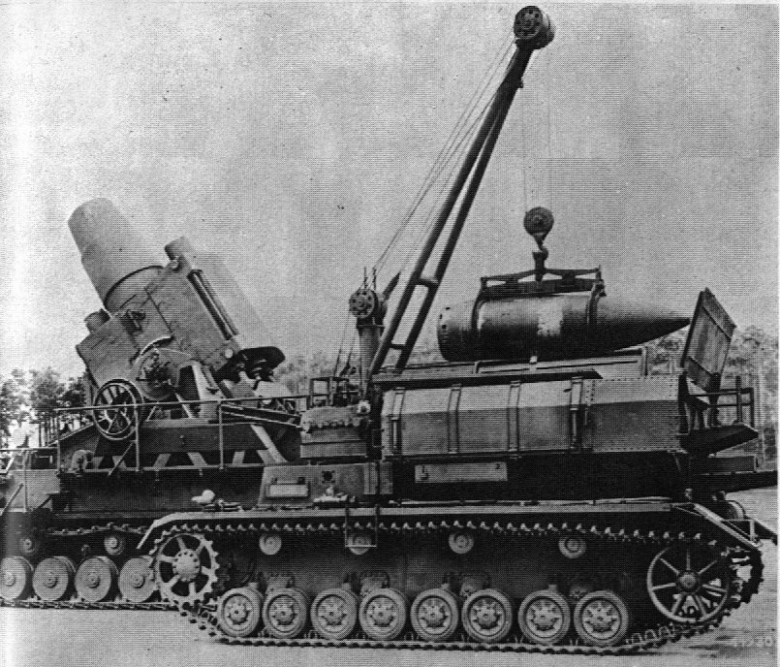
Reloading a KARL
Notes:
Reloading a KARL

Slide 20
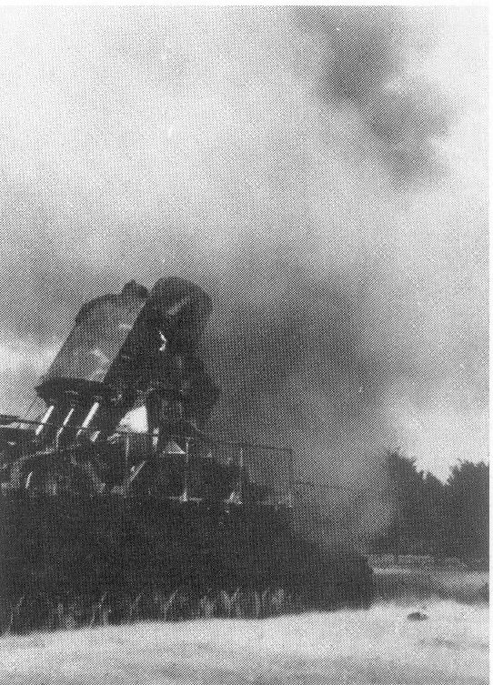
BOOM!
Notes:
BOOM!

Slide 21
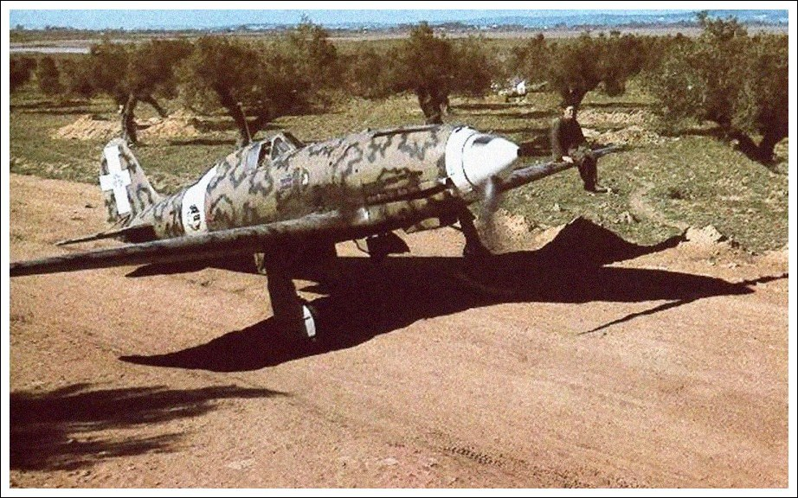
Macchi 202v
Notes:
Macchi 202v

Slide 22
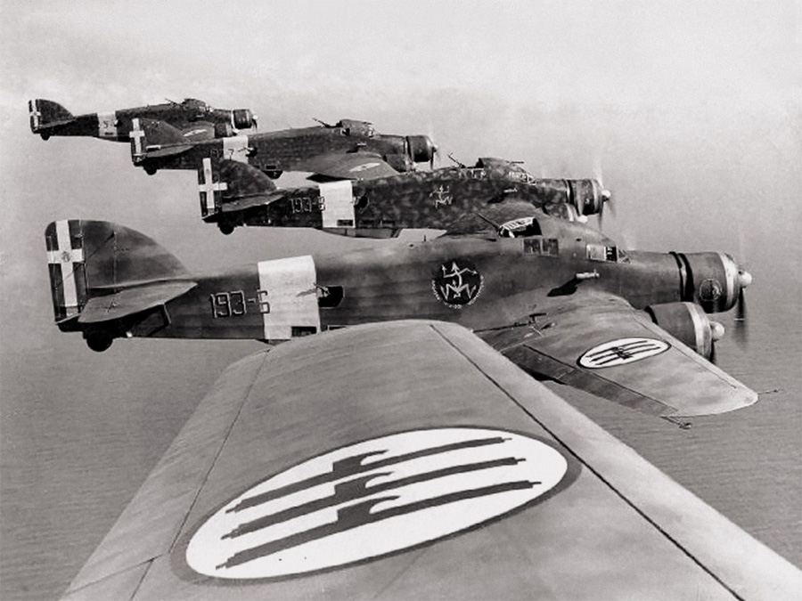
Italian 303 Bombers over North Africa
Notes:
Italian 303 Bombers over North Africa

